Slide 1
CSC476 Introduction to Computer Vision Lecture 4
More on Histogram Equalization, Border Effect, Image Derivatives, Edge Detection
Bei Xiao

Slide 2
Last lecture
Linear Algebra Review
Gaussian Kernel
Histogram Equalization

Slide 3
Today’s Lecture
More on image histograms
Border effect and padding
Image Derivatives/gradients
Canny edge detection

Slide 4
Learning objective check
You should be so far:
1) fluent with convolving images with filter
2) fluent with convolving matrix with another matrix.
3) Know basic Numpy matrix manipulation.
4) Create box, 2D Gaussian and 1D Gaussian filters of all sizes.

Slide 5
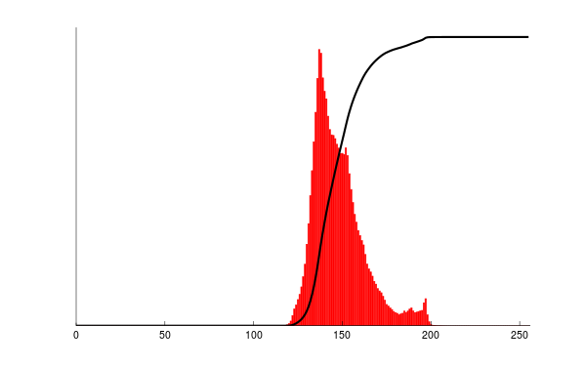

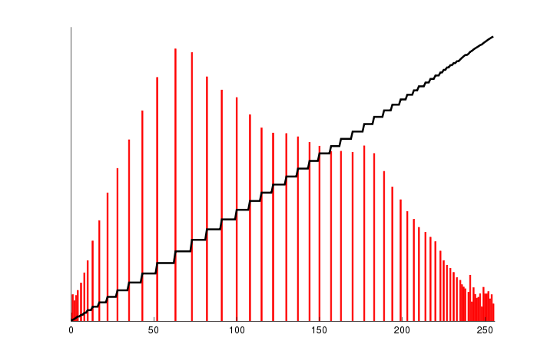
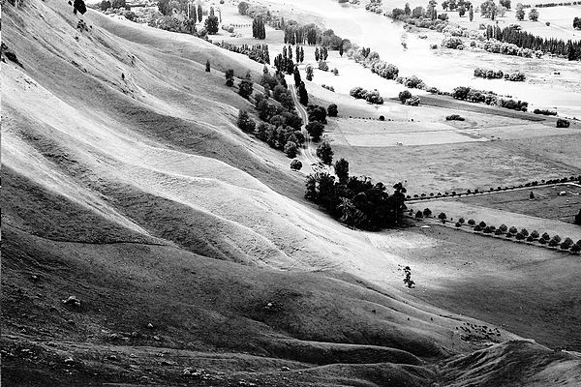
Image Histogram Equalization
Notice the “shape” of the histogram is preserved!
Same number of pixels
In each bin!

Slide 6
Questions
Why don’t we do the equalization directly on the histograms? What will happen to the image if it has a perfectly flat histograms?
What is CDF? Why are there steps (zig-zags) on the CDF?
How to make sure the “shape” of the PDF is preserved in the transformation?

Slide 7
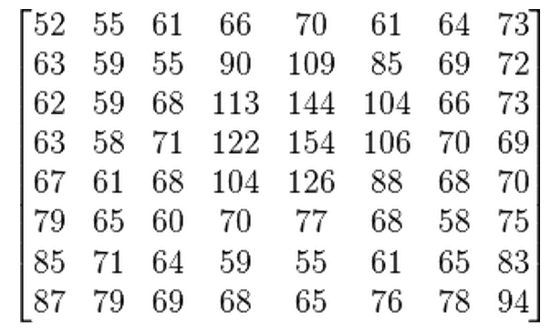
Let’s look at in more details
We start with a gray-scale jpeg image of 8 by 8
https://en.wikipedia.org/wiki/Histogram_equalization

Slide 8
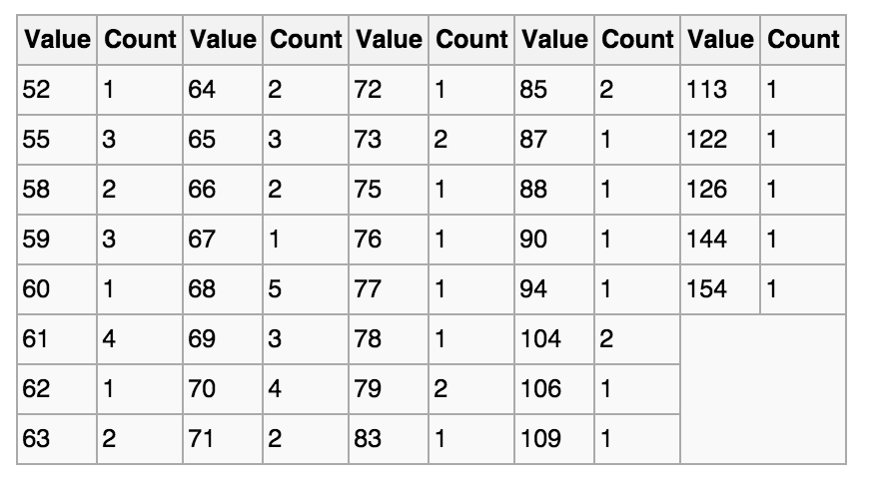
Let’s look at in more details
The histograms for this image (8 by 8 pixels) is shown in the following table (intensity that has zero pixels are skipped:

Slide 9
Let’s look at in more details
The cumulative distribution function (CDF) is shown below
Value | cdf | scaled cdf
52 | 1 | 0
55 | 4
58 | 6
59 | 9
60 | 10
61 | 14
62 | 15
… | …
154 | 64 | 255
This cdf shows that the min value in the subimage is 52 and max is 154. The cdf of value 154 corresponding to the total number of pixels (64)
Number of pixels

Slide 10
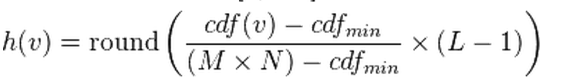
Let’s look at in more details
How do we compute the normalized CDF?
Cdf(v): original cdf of pixel v
Cdfmin: minimum non-zero vale of the cdf
M×N: number of pixels, e.g. 64 (8x8)
L: 256

Slide 11
Quiz:
How do we compute normalized CDF of pixel 62?
Value | cdf | scaled cdf
52 | 1 | 0
55 | 4
58 | 6
59 | 9
60 | 10
61 | 14
62 | 15 | ?
… | …
154 | 64 | 255

Slide 12
Quiz:
How do we compute normalized CDF of pixel 62?
Value | cdf | scaled cdf
52 | 1 | 0
55 | 4
58 | 6
59 | 9
60 | 10
61 | 14
62 | 15 | ?
… | …
154 | 64 | 255
H(62) = round((15-1)/63*255)
= 57

Slide 13
Let’s look at in more details
The cumulative distribution function (CDF) is shown below
Value | cdf | scaled cdf
52 | 1 | 0
55 | 4 | 12
58 | 6 | 22
59 | 9 | 32
60 | 10 | 36
61 | 14 | 53
62 | 15 | 57
… | … | …
154 | 64 | 255

Slide 14
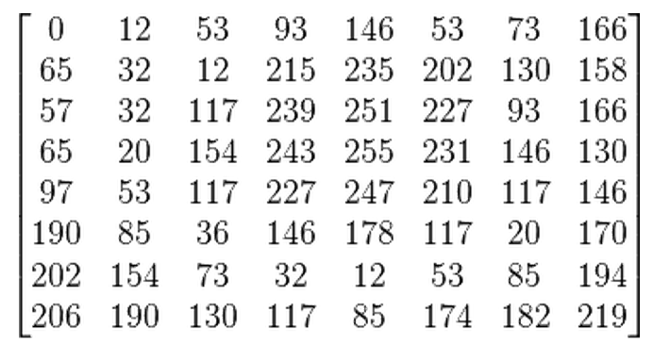
Let’s look at in more details
Now we can directly map the scaled cdf back to pixel values using the look up table we derived above
52
55
61
66

Slide 15
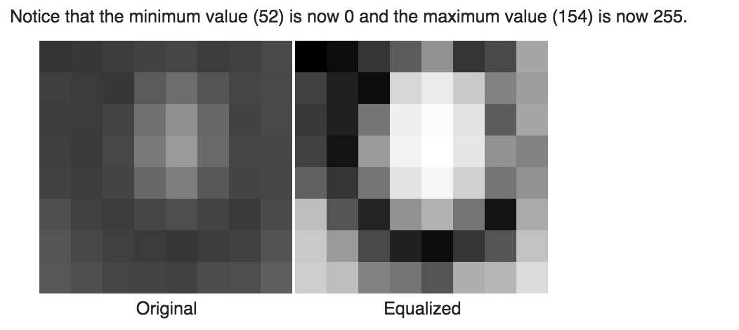
Let’s look at in more details

Slide 16
Let’s look at in more details

Slide 17
Homework 2: histogram equalization
Hint:
# read in the image
im = misc.imread('lowcontrast.jpg',flatten=1)
#Compute cdf in Python:
np.histogram(im.flatten(),nbr_bins,normed=True)
cdf = imhist.cumsum()
# normalize
cdf = 255 * cdf / cdf[-1]
# Using linear interpretation of cdf to find new pixels.
im2 = np.interp(im.flatten(),bins[:-1],cdf)

Slide 18
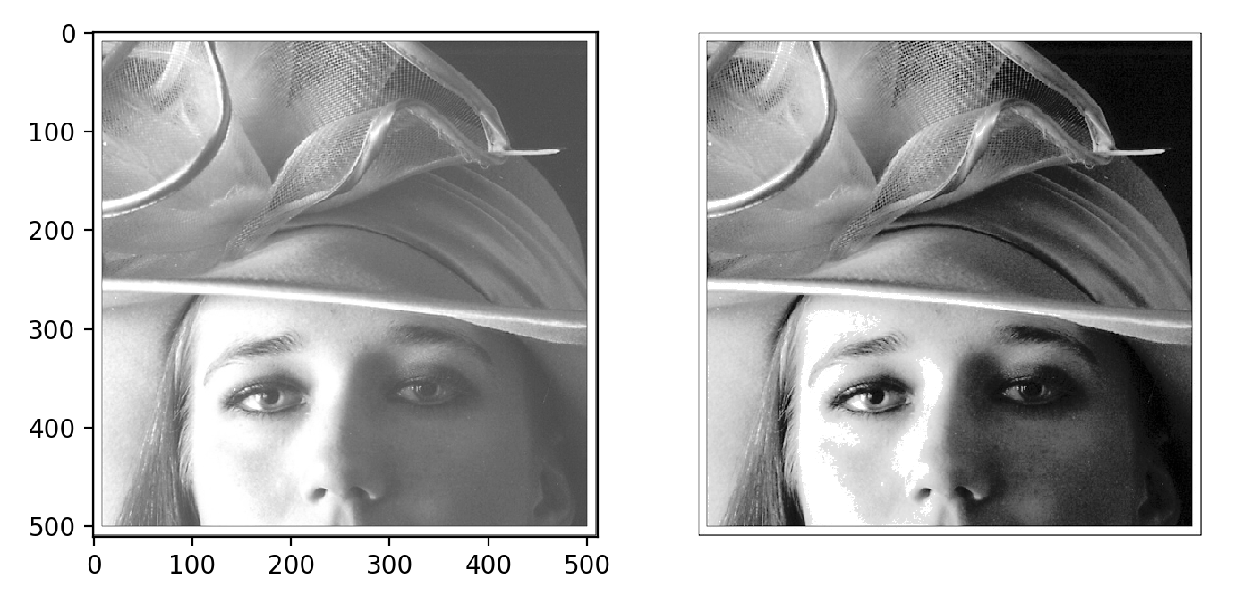
Homework 2: histogram equalization

Slide 19

Back to Convolution
Let’s blur a flat gray image:
How should it look like?

Slide 20
Back to Convolution
Convolve with a box kernel
1/9 | 1/9 | 1/9
1/9 | 1/9 | 1/9
1/9 | 1/9 | 1/9
20 | 20 | 20 | 20
20 | 20 | 20 | 20
20 | 20 | 20 | 20
20 | 20 | 20 | 20

Slide 21
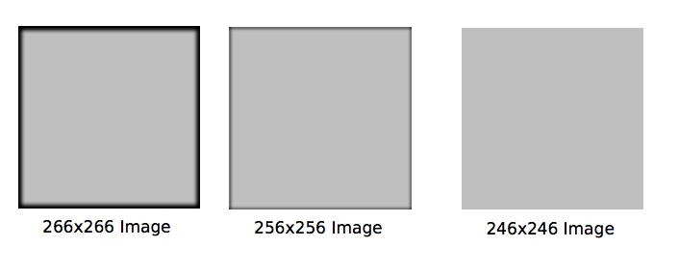
Border Handling
Depending on how you do the convolution, you could end up with 3 different images.
full
same
valid

Slide 22
Back to Convolution
Zero padding:
Filled in borders with zeros, computed everywhere the kernel touches.
Numpy.convolve(a,v,mode =‘full’ or ‘same’)
This returns the convolution at each point of overlap, with an output shape of (N+M-1,). At the end-points of the convolution, the signals do not overlap completely, and boundary effects may be seen.

Slide 23
Back to Convolution
Convolve with a box kernel, suppose there are zeros outside the image matrix.
1/9 | 1/9 | 1/9
1/9 | 1/9 | 1/9
1/9 | 1/9 | 1/9
8.9 | 13.3 | 13.3 | 8.9
13.3 | 20.0 | 20.0 | 13.3
13.3 | 20.0 | 20.0 | 13.3
8.9 | 13.3 | 13.3 | 8.9
20 | 20 | 20 | 20
20 | 20 | 20 | 20
20 | 20 | 20 | 20
20 | 20 | 20 | 20

Slide 24
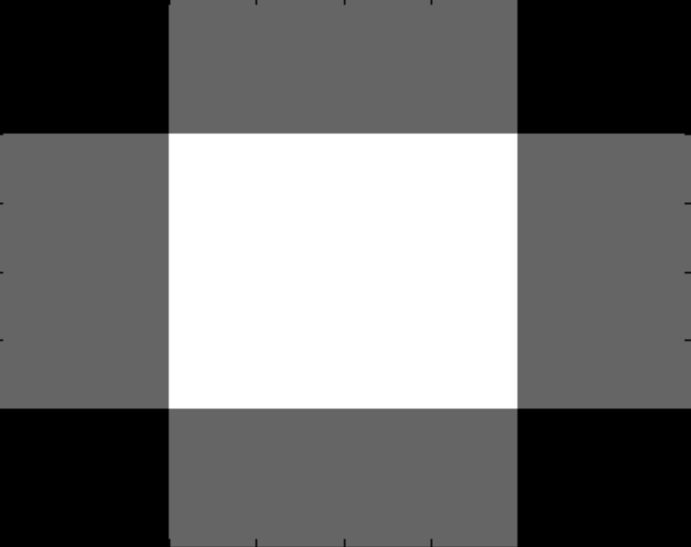
Back to Convolution
This is called “same” in MATLAB/Numpy
4 ×4
4 ×4

Slide 25
Back to Convolution
1/9 | 1/9 | 1/9
1/9 | 1/9 | 1/9
1/9 | 1/9 | 1/9
2.2 | 4.4 | 6.6 | 6.6 | 4.4 | 2.2
4.4 | 8.9 | 13.3 | 13.3 | 8.9 | 4.4
6.6 | 13.3 | 20.0 | 20.0 | 13.3 | 6.7
6.6 | 13.3 | 20.0 | 20.0 | 13.3 | 6.7
4.4 | 8.9 | 13.3 | 13.3 | 8.9 | 4.4
2.2 | 4.4 | 6.6 | 6.6 | 4.4 | 2.2
20 | 20 | 20 | 20
20 | 20 | 20 | 20
20 | 20 | 20 | 20
20 | 20 | 20 | 20

Slide 26
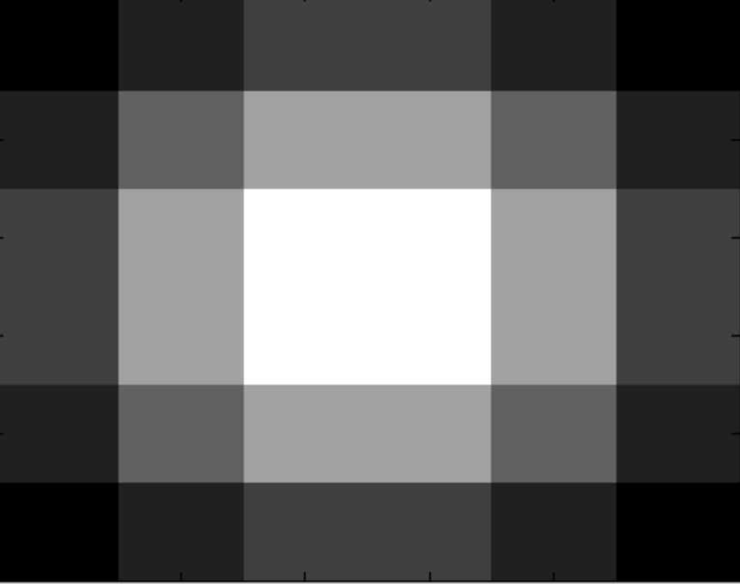
Back to Convolution
This is called “full” in MATLAB/Numpy.
4 ×4
6 ×6

Slide 27
Back to Convolution
Only compute at places where the kernel fits the image
1/9 | 1/9 | 1/9
1/9 | 1/9 | 1/9
1/9 | 1/9 | 1/9
20 | 20 | 20 | 20
20 | 20 | 20 | 20
20 | 20 | 20 | 20
20 | 20 | 20 | 20
20 | 20
20 | 20

Slide 28
Back to Convolution
This is called “valid” in MATLAB/Numpy.
4 ×4
2 ×2

Slide 29
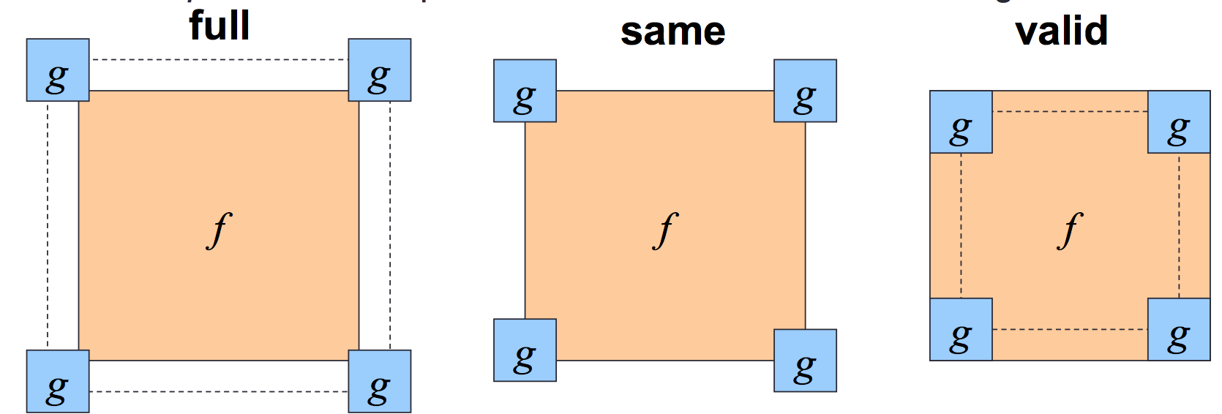
To summarize
Python:
Numpy.convolve(a,v,mode=“full”)
Scipy.signal.convole2d(a,v,mode, boundary, value)

Slide 30
There are other methods
The first two methods that I described fill missing values in by substituting zero
Can fill in values with different methods
Reflect image along border
Pull values from other side
Read Chapter 3.2 “padding”.
scipy.ndimage.convolve(input, weights, output-None, mode =“reflect”)

Slide 31
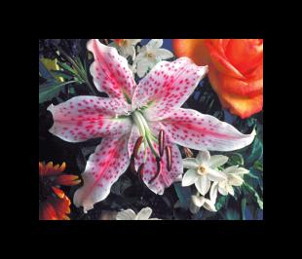
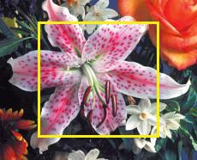

There are other methods
zero
valid
Nearest neighbor

Slide 32
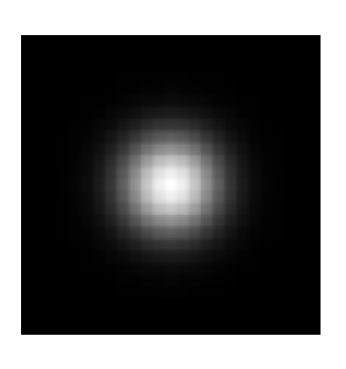
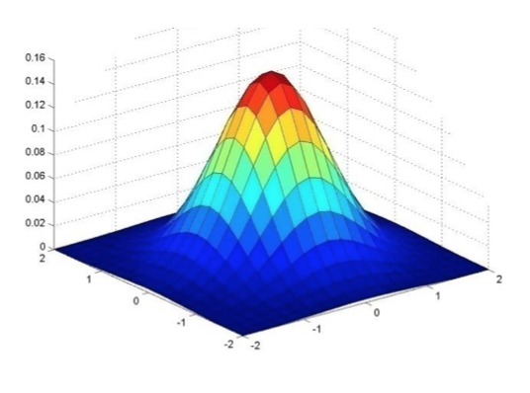
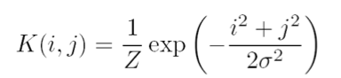
Gaussian Filter
Gaussian = normal distribution function

Slide 33
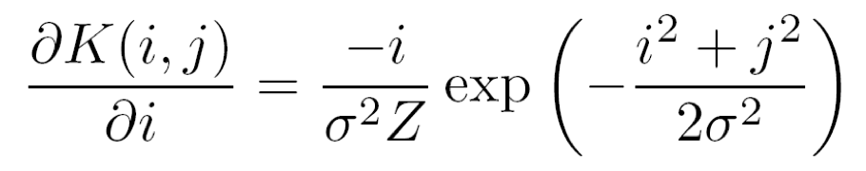
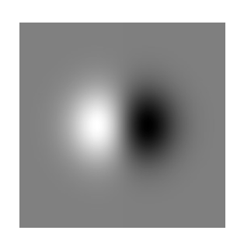
Derivative of Gaussian
Take the derivative of the filter with respect to i:
Filter looks like:
Basically blur then take the derivative
Source: M. Tappen
Notes:
How many 2nd derivative filters are there? There are four 2nd partial derivative filters.
In practice, it’s handy to define a single 2nd derivative filter—the Laplacian

Slide 34
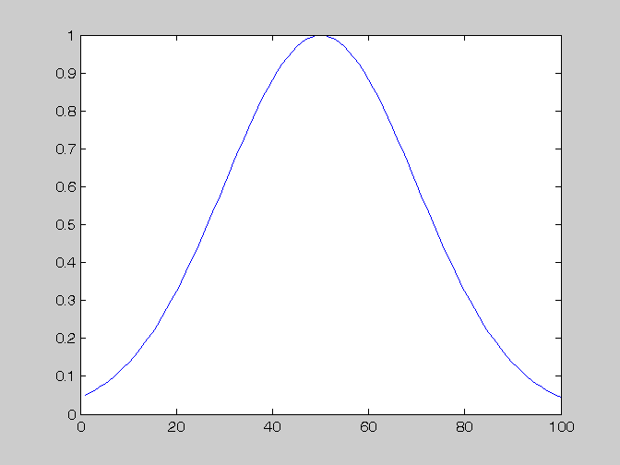
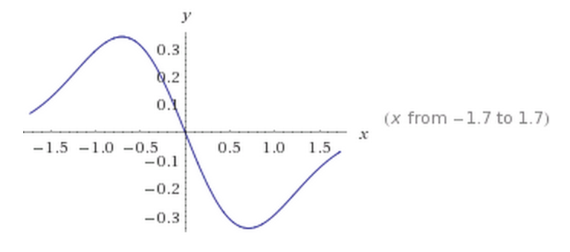
Derivative of Gaussian
Notes:
How many 2nd derivative filters are there? There are four 2nd partial derivative filters.
In practice, it’s handy to define a single 2nd derivative filter—the Laplacian

Slide 35
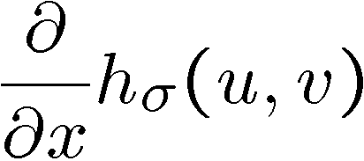
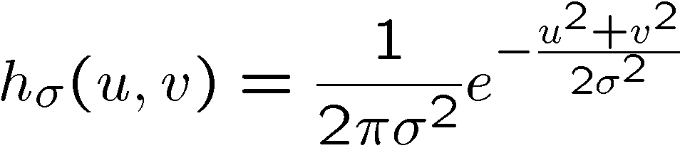
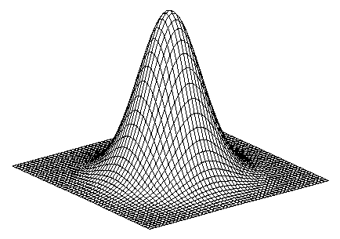
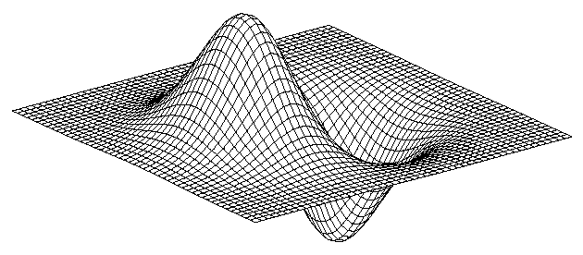
2D edge detection filters
derivative of Gaussian (x)
Gaussian
Notes:
How many 2nd derivative filters are there? There are four 2nd partial derivative filters.
In practice, it’s handy to define a single 2nd derivative filter—the Laplacian

Slide 36
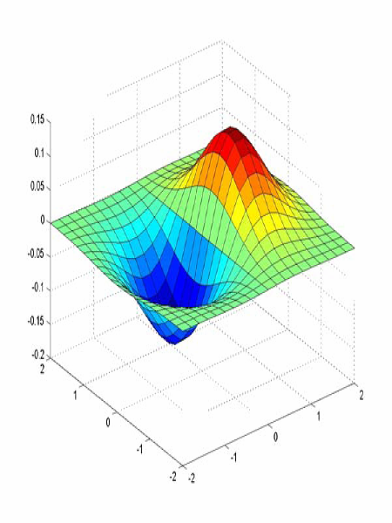
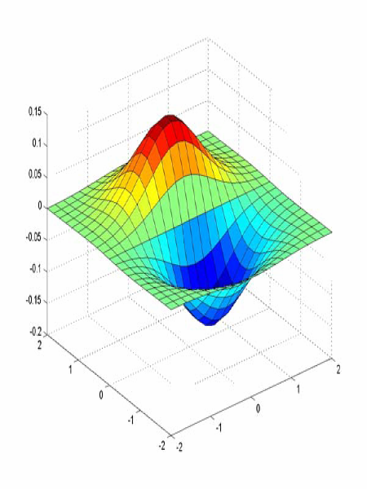


Derivative of Gaussian filter
x-direction
y-direction

Slide 37
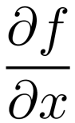
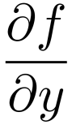
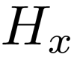
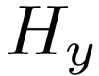
Image derivatives
How can we differentiate a digital image F[x,y]?
Option 1: reconstruct a continuous image, f, then compute the derivative
Option 2: take discrete derivative (finite difference)
How would you implement this as a linear filter?
1 | -1
 | -1
 | 1
:
:
Source: S. Seitz

Slide 38

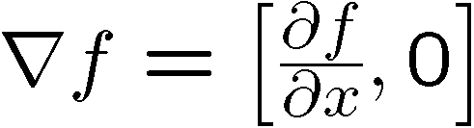
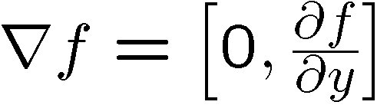
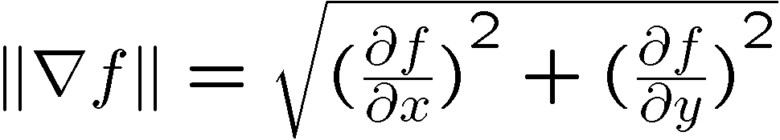
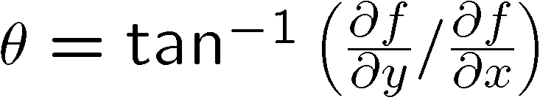
Image gradient
The gradient of an image:
The gradient points in the direction of most rapid increase in intensity
The edge strength is given by the gradient magnitude:
The gradient direction is given by:
how does this relate to the direction of the edge?
Source: Steve Seitz
Notes:
give definition of partial derivative: lim h->0 [f(x+h,y) – f(x,y)]/h

Slide 39

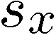
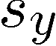
The Sobel operator
Common approximation of derivative of Gaussian
-1 | 0 | 1
-2 | 0 | 2
-1 | 0 | 1
1 | 2 | 1
0 | 0 | 0
-1 | -2 | -1
The standard defn. of the Sobel operator omits the 1/8 term
doesn’t make a difference for edge detection
the 1/8 term is needed to get the right gradient value
Notes:
39
Q: Why might these work better?
A: more stable when there is noise

Slide 40
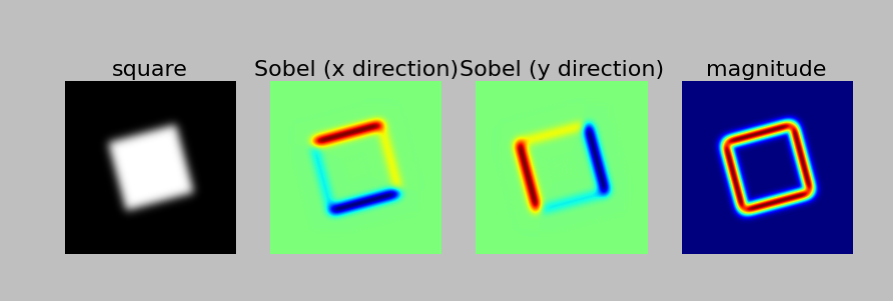
Example of Sobel filtered image
Notes:
40
Q: Why might these work better?
A: more stable when there is noise

Slide 41
Image gradient
Source: L. Lazebnik

Slide 42
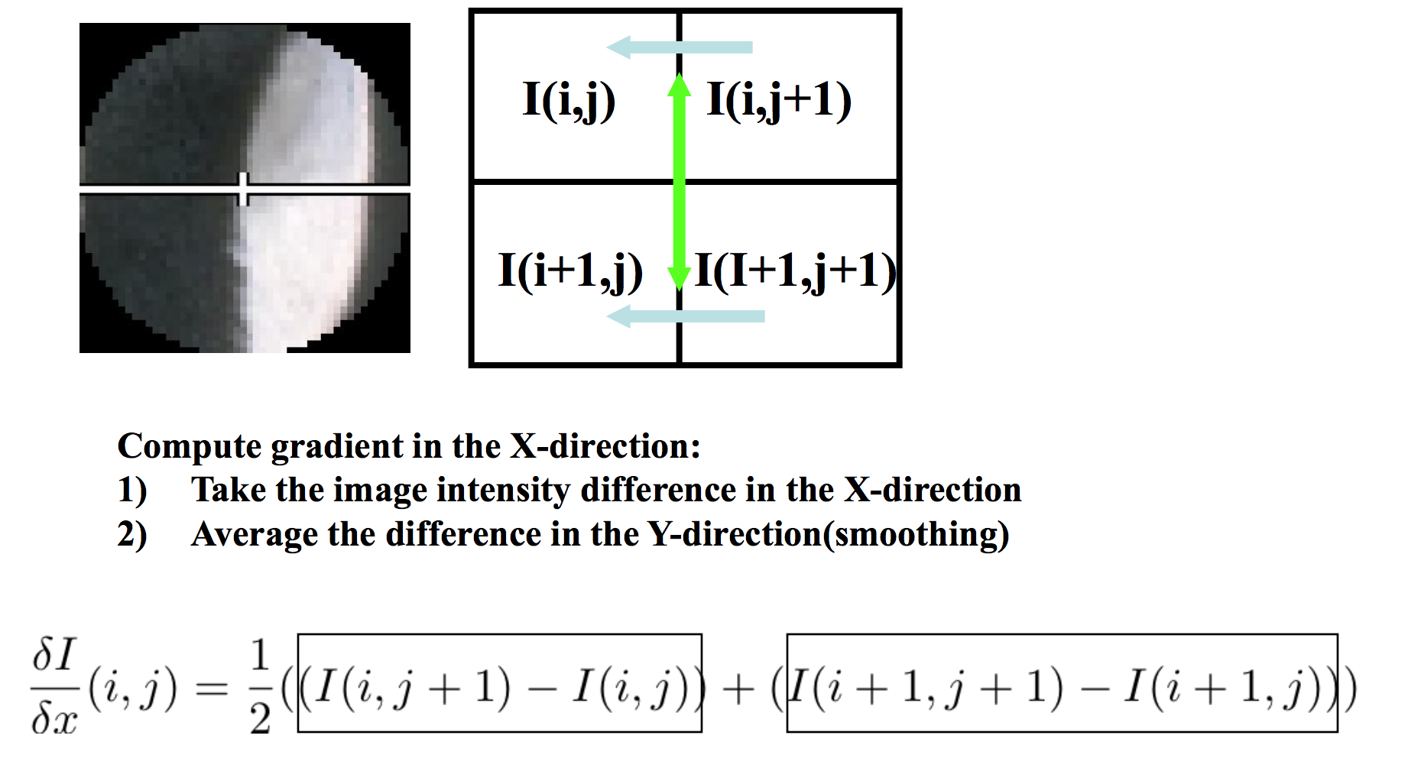
Compute gradient: first order derivatives
Slide source: Jianbo Shi

Slide 43
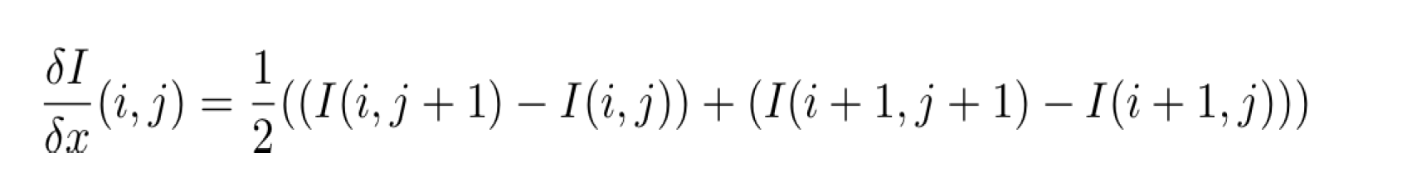
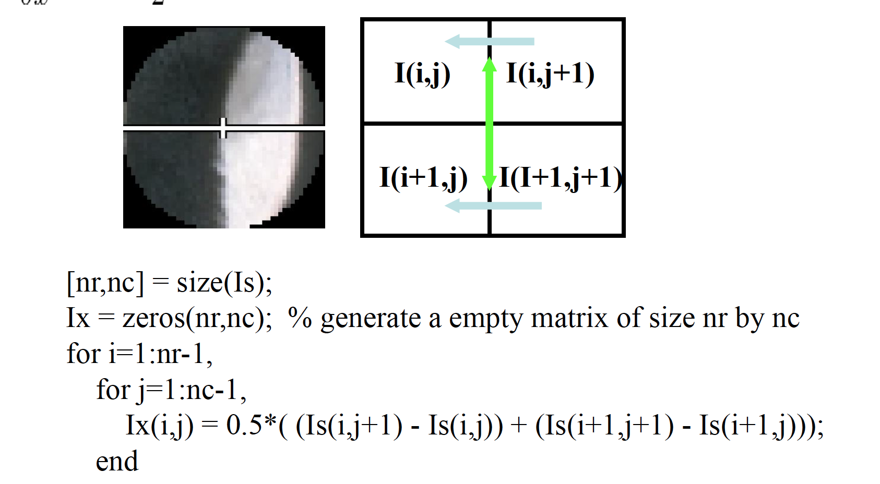
Compute gradient: first order derivatives
Slide source: Jianbo Shi

Slide 44
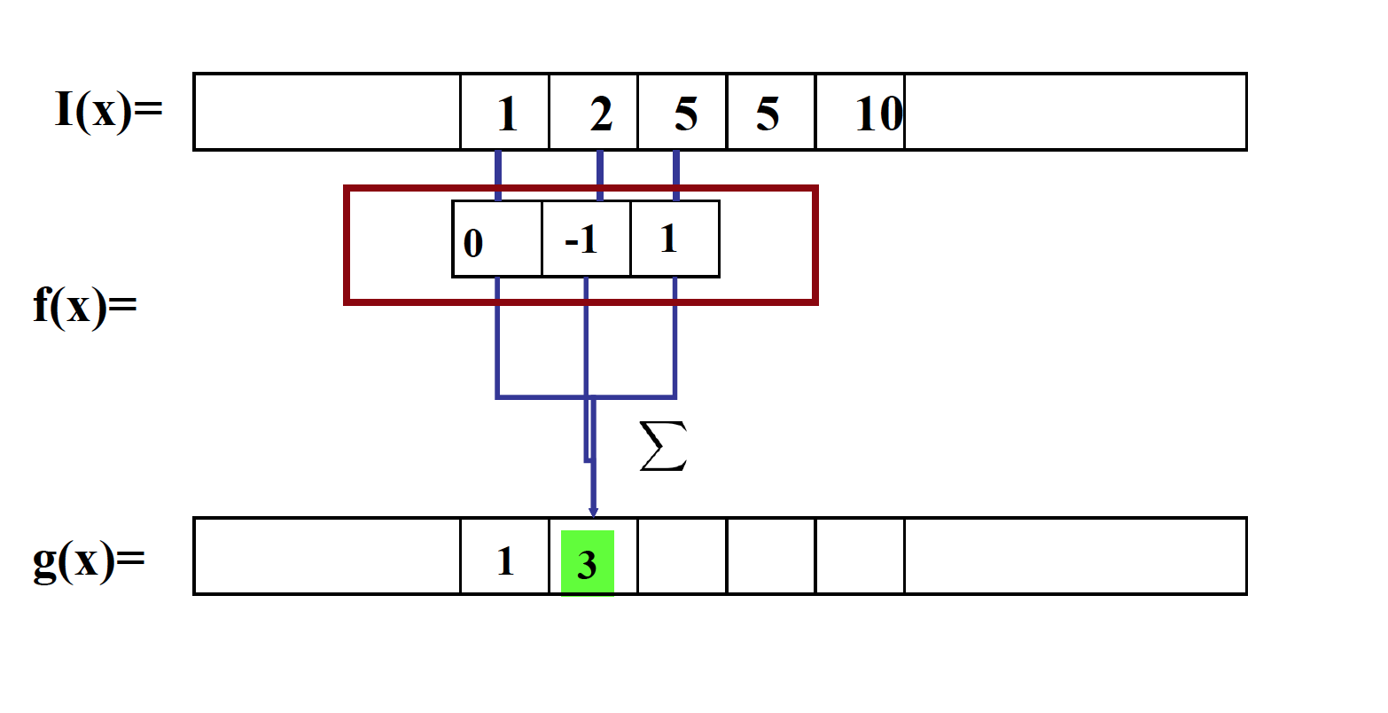
Compute gradient as convolution operation!

Slide 45
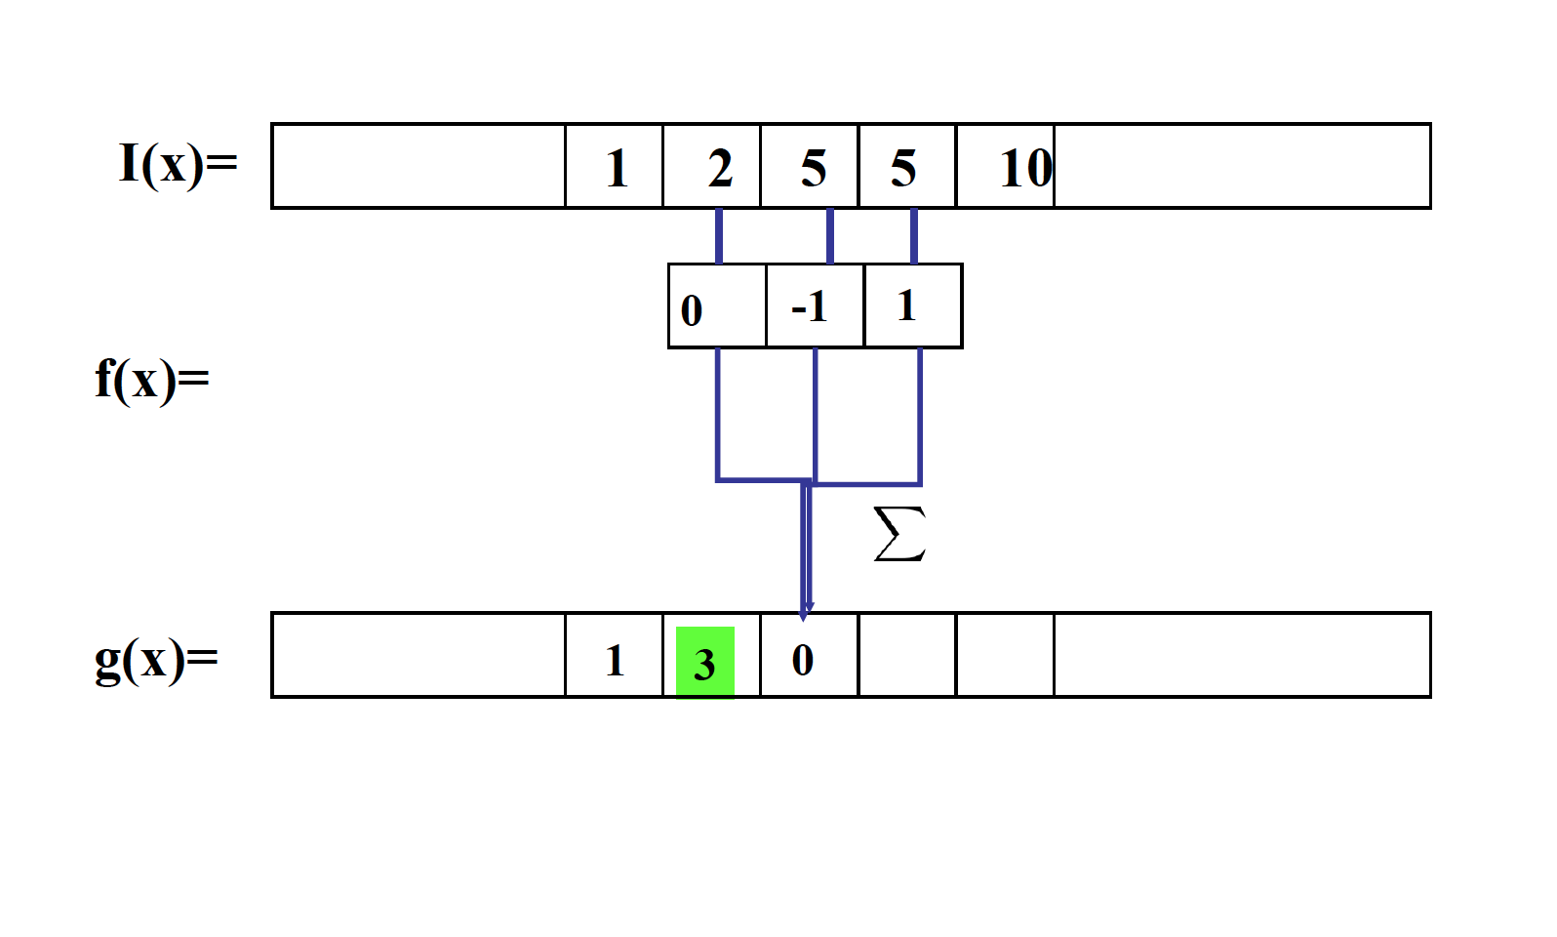
Compute gradient as convolution operation!

Slide 46
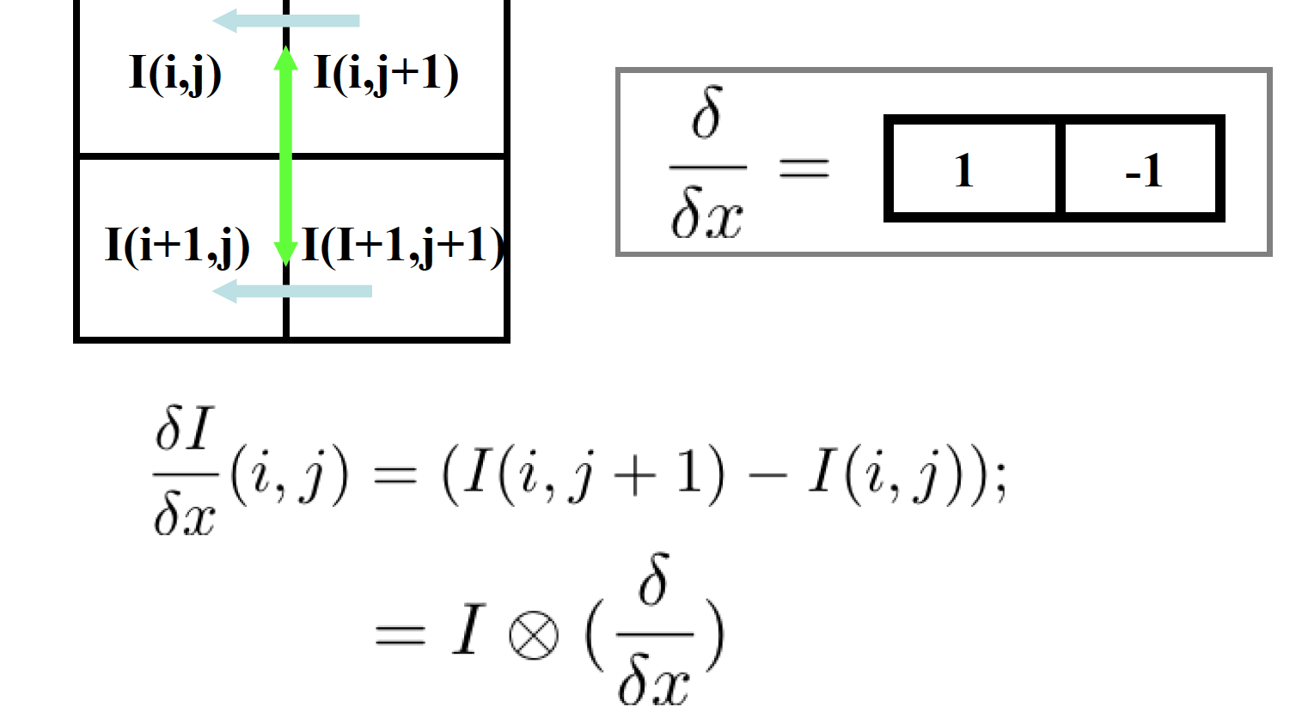
Compute gradient: first order derivatives

Slide 47
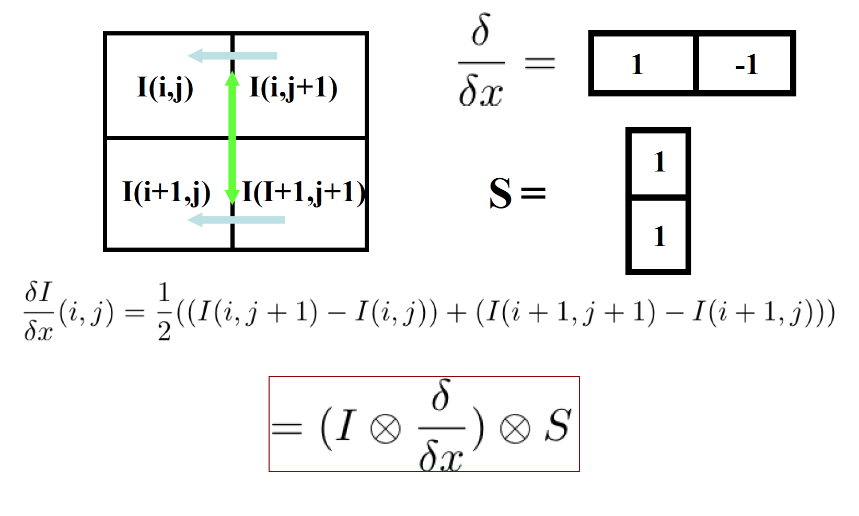
Compute gradient: first order derivatives

Slide 48
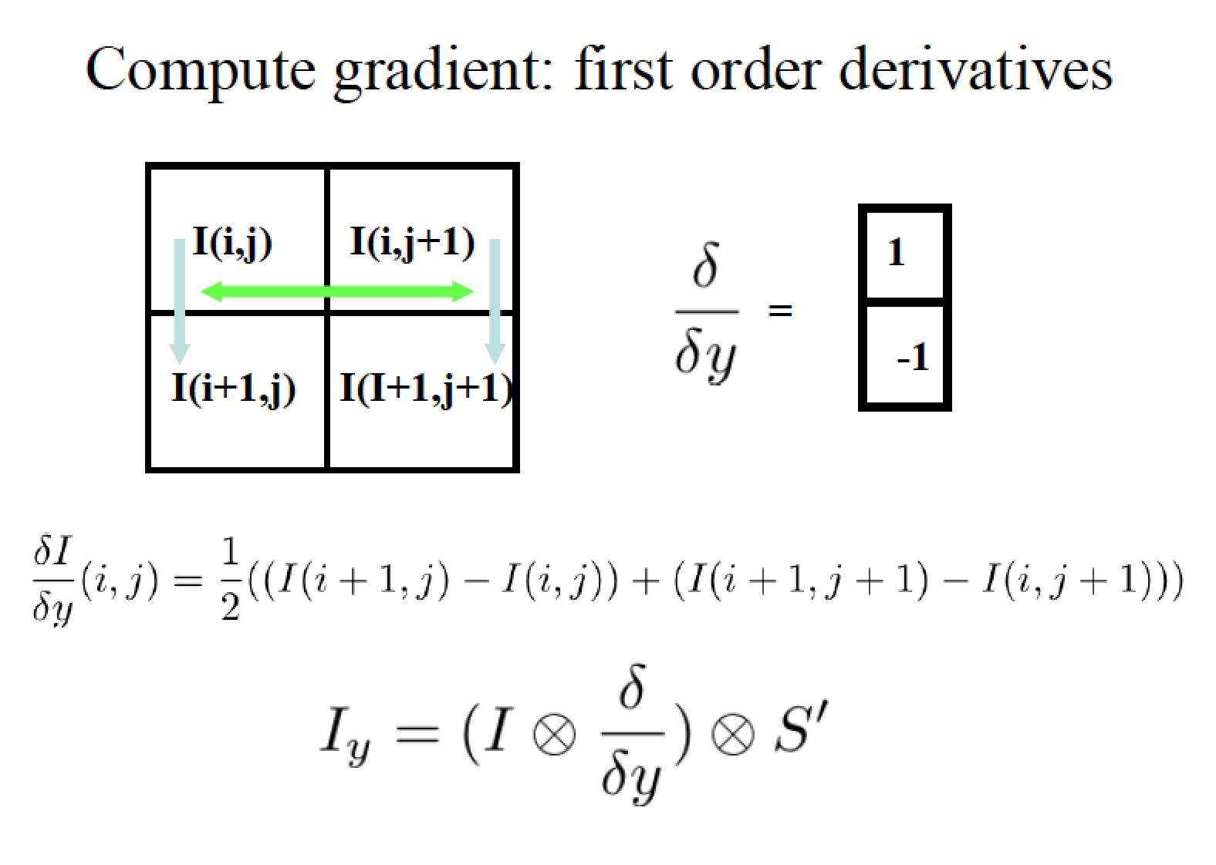

Slide 49

Example

Slide 50
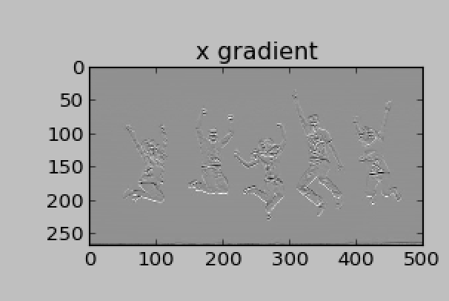
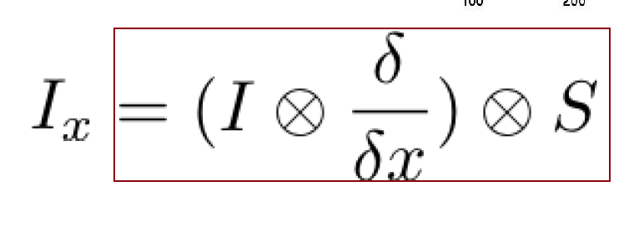
Exercise in Python
s1 = np.array([1,1])
dx = np.array([1,-1])
dy = np.array([1,-1])
x = ndimage.convolve1d(l,dx,axis= 0)
gx_I = ndimage.convolve(x,s)

Slide 51
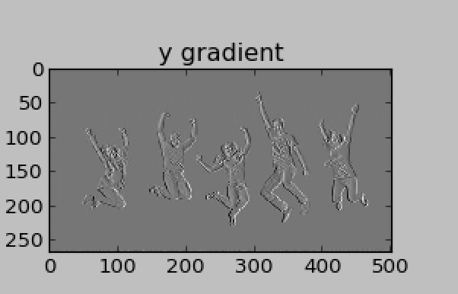

Usage in Python
s1 = np.array([1,1])
dx = np.array([1,-1])
dy = np.array([1,-1])
y = ndimage.convolve1d(l,dx,axis= 1)
gy_I = ndimage.convolve(y,s)
Or : gx_I,gy_I = np.gradient(l)[:2]

Slide 52

Smoothed derivative filter
Notes:
http://docs.scipy.org/doc/numpy/reference/generated/numpy.gradient.html

Slide 53

Sobel Filter
Product of averaging and gradient.
An cross product of two 1 d filter, Gaussian and gradient

Slide 54
Exercise: Create image derivatives using Sobel filter
Generate an image of a rotated rectangle
import numpy as np
from scipy import ndimage
import matplotlib.pyplot as plt
im = np.zeros((256, 256))
im[64:-64, 64:-64] = 1
im = ndimage.rotate(im, 15, mode='constant’)
2. Blur the image using a Gaussian filter
im = ndimage.gaussian_filter(im, 8)
3. Apply Sobel filter to both x and y direction.
sx = ndimage.sobel(im, axis=0, mode='constant’)
4. Display the original image, x-derivatives, y-derivatives, and the gradient magnitude. You can use np.hypot to compute magnitude.
See here: http://docs.scipy.org/doc/numpy/reference/generated/numpy.hypot.html)

Slide 55






Where do humans see boundaries?
image
human segmentation
gradient magnitude
Berkeley segmentation database: http://www.eecs.berkeley.edu/Research/Projects/CS/vision/grouping/segbench/

Slide 56

Edge detection
Goal: Identify sudden changes (discontinuities) in an image
Intuitively, most semantic and shape information from the image can be encoded in the edges
More compact than pixels
Ideal: artist’s line drawing (but artist is also using object-level knowledge)
Source: D. Lowe

Slide 57

Why do we care about edges?
Extract information, recognize objects
Recover geometry and viewpoint
Vertical vanishing
point
(at infinity)
Vanishing
line
Vanishing
point
Vanishing
point

Slide 58

Origin of Edges
surface normal discontinuity
depth discontinuity
surface color discontinuity
illumination discontinuity
Edges are caused by a variety of factors
Source: Steve Seitz

Slide 59

Closeup of edges
Source: D. Hoiem

Slide 60
Closeup of edges
Source: D. Hoiem

Slide 61
Closeup of edges
Source: D. Hoiem

Slide 62
Closeup of edges
Source: D. Hoiem

Slide 63
Edge is Where Change Occurs
Change is measured by derivative in 1D
Biggest change, derivative has maximum magnitude
Or 2nd derivative is zero.

Slide 64

Edge is Where Change Occurs

Slide 65

Characterizing edges
An edge is a place of rapid change in the image intensity function
intensity function (along horizontal scanline)
image
first derivative
edges correspond to extrema of derivative

Slide 66


Slide 67




Effects of noise
Consider a single row or column of the image
Plotting intensity as a function of position gives a signal
Where is the edge?
Source: S. Seitz
Notes:
How to fix?

Slide 68
Effects of noise
Difference filters respond strongly to noise
Image noise results in pixels that look very different from their neighbors
Generally, the larger the noise the stronger the response
What can we do about it?
Source: D. Forsyth

Slide 69




Solution: smooth first
f
g
f * g
To find edges, look for peaks in
Source: S. Seitz

Slide 70

Derivative theorem of convolution
Differentiation is convolution, and convolution is associative:
This saves us one operation:
f
Source: S. Seitz

Slide 71


Slide 72

* [1 -1] =

Slide 73


Slide 74


Slide 75


Slide 76


What kind of filters are those?
Sobel filter:
Magnitude:
Direction:
Notes:
Is this filter separable?

Slide 77




Tradeoff between smoothing and localization
1 pixel
3 pixels
7 pixels
Source: D. Forsyth

Slide 78

Original
σ= 1 pixel
σ= 2 pixel
Source: D. Forsyth

Slide 79

Implementation issues
The gradient magnitude is large along a thick “trail” or “ridge,” so how do we identify the actual edge points?
How do we link the edge points to form curves?
Source: D. Forsyth
Notes:
Figures show gradient magnitude of zebra at two different scales

Slide 80
Designing an edge detector
Criteria for a good edge detector:
Good detection: the optimal detector should find all real edges, ignoring noise or other artifacts
Good localization
the edges detected must be as close as possible to the true edges
the detector must return one point only for each true edge point
Cues of edge detection
Differences in color, intensity, or texture across the boundary
Continuity and closure
High-level knowledge
Source: L. Fei-Fei

Slide 81
Canny edge detector
This is probably the most widely used edge detector in computer vision
Theoretical model: step-edges corrupted by additive Gaussian noise
Canny has shown that the first derivative of the Gaussian closely approximates the operator that optimizes the product of signal-to-noise ratio and localization
J. Canny, A Computational Approach To Edge Detection, IEEE Trans. Pattern Analysis and Machine Intelligence, 8:679-714, 1986.
Source: L. Fei-Fei

Slide 82
Canny edge detector
Minimizes the probability of multiply detecting an edge
Minimizes the probability of failing to detect an edge
Minimizes the distance of the reported edge to the true edge.
J. Canny, A Computational Approach To Edge Detection, IEEE Trans. Pattern Analysis and Machine Intelligence, 8:679-714, 1986.
Source: L. Fei-Fei

Slide 83
Note about Matlab’s Canny detector
Small errors in implementation
Gaussian function not properly normalized
First filters with a Gaussian, then a difference of Gaussian (equivalent to filtering with a larger Gaussian and taking difference)

Slide 84

Example
original image (Lena)

Slide 85
Derivative of Gaussian filter
x-direction
y-direction

Slide 86



Compute Gradients (DoG)
X-Derivative of Gaussian
Y-Derivative of Gaussian
Gradient Magnitude

Slide 87
The Canny edge detector
original image (Lena)

Slide 88

The Canny edge detector
norm of the gradient

Slide 89

The Canny edge detector
thresholding

Slide 90

The Canny edge detector
thinning
(non-maximum suppression)

Slide 91

Get Orientation at Each Pixel
Threshold at minimum level
Get orientation
theta = atan2(gy, gx)

Slide 92


Non-maximum suppression for each orientation (edge thinning)
At q, we have a maximum if the value is larger than those at both p and at r. Interpolate to get these values.
Source: D. Forsyth

Slide 93

Non-maximum suppression for each orientation

Slide 94

Non-maximum suppression
m(x,y) is the local peak
Canny calls local peak detection non-maximum suppression
M(x,y) is a local peak whenever it is greater than the values in the gradient direction and the opposite of the gradient direction.

Slide 95

Non-maximum suppression

Slide 96

Non-maximum suppression

Slide 97

Non-maximum suppression

Slide 98

Non-maximum suppression

Slide 99
Before Non-max Suppression

Slide 100

After non-max suppression

Slide 101
Edge linking
Assume the marked point is an edge point. Then we construct the tangent to the edge curve (which is normal to the gradient at that point) and use this to predict the next points (here either r or s).
Source: D. Forsyth

Slide 102



Sidebar: Bilinear Interpolation
http://en.wikipedia.org/wiki/Bilinear_interpolation

Slide 103



Sidebar: Interpolation options
imx2 = imresize(im, 2, interpolation_type)
‘nearest’
Copy value from nearest known
Very fast but creates blocky edges
‘bilinear’
Weighted average from four nearest known pixels
Fast and reasonable results
‘bicubic’ (default)
Non-linear smoothing over larger area (4x4)
Slower, visually appealing, may create negative pixel values
Examples from http://en.wikipedia.org/wiki/Bicubic_interpolation

Slide 104
Before Non-max Suppression

Slide 105

After non-max suppression

Slide 106
Double thresholding
The remaining pixels are then categorized into strong, weak and non-edges.
Above a high threshold, mark as strong.
Between high and lo, mark as weak.
Below lo threshold, mark as non-edges

Slide 107

Hysteresis thresholding
Threshold at low/high levels to get weak/strong edge pixels
Do connected components, starting from strong edge pixels

Slide 108
Hysteresis thresholding
Check that maximum value of gradient value is sufficiently large
drop-outs? use hysteresis
use a high threshold to start edge curves and a low threshold to continue them.
Source: S. Seitz

Slide 109

Hysteresis thresholding

Slide 110

Final Canny Edges

Slide 111

Canny Edge Operator

Slide 112





Effect of σ (Gaussian kernel spread/size)
original
Canny with
Canny with
The choice of σ depends on desired behavior
large σ detects large scale edges
small σ detects fine features
Source: S. Seitz

Slide 113
Canny detection with Python
Read in an image and filter with a Gaussian filter.
Apply sobel filter to x and y direction.
Computer gradients magnitudes and orientation.
Performing non-maximum suppression upper threshold
Perform threading ad labeling edge maps.
Compare your result with :
cv2.Canny2()
http://dasl.unlv.edu/daslDrexel/alumni/bGreen/www.pages.drexel.edu/_weg22/can_tut.html

Slide 114
Take-home reading
Szeliski Chapter 4.2 Edges
A very good introduction of Canny edge detection:
http://www.classes.cs.uchicago.edu/archive/2005/fall/35040-1/edges.pdf
A youtube video is also helpful:
https://www.youtube.com/watch?v=-Z3kr26Eci4

Slide 115
Next class
Laplacian of Gaussian
Steerable filter
Fourier transform
Reading: Chapter 3.1-3.3! Very important to keep up the reading.
You should have read Chapter 1. Skip Chapter 2 since we haven’t covered it.

